Slide 1

1
Notes:
1

Slide 2

OBJECTIVE
Connecting readers through shared tastes
A smart system that learns what you’ll
love next
2
Notes:
2

Slide 3
DATASET DETAILS
Books dataset utilized for this project comprises detailed records covering all relevant parameters required for analysis.
ISBN, BOOK-TITLE, BOOK-AUTHOR, YEAR- OF-PUBLICATION, PUBLISHER, IMAGES-URL
USERS dataset utilized for this project comprises detailed records covering all relevant parameters required for analysis.
USER-ID , LOCATION & AGE
RATINGS dataset utilized for this project comprises detailed records covering all relevant parameters required for analysis.
USER-ID, ISBN & RATING
3
Notes:
3

Slide 4

EXPLORATORY DATA ANALYSIS
Exploratory Data Analysis (EDA) was conducted to gain a deeper understanding of the dataset and uncover underlying patterns, trends, and relationships among the variables.
EDA Procedures
1. Data Understanding
2. Data Cleaning
3. Data Exploration
4. Data Visualization
5. Feature Analysis & Transformation
6. Insights & Summary
4
Notes:
4

Slide 5
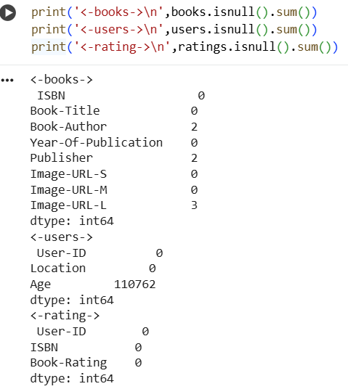
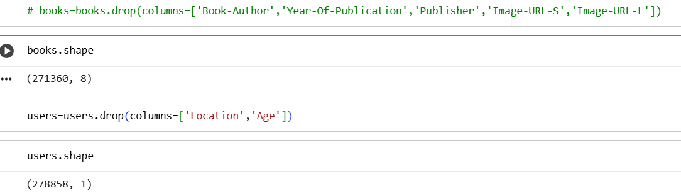
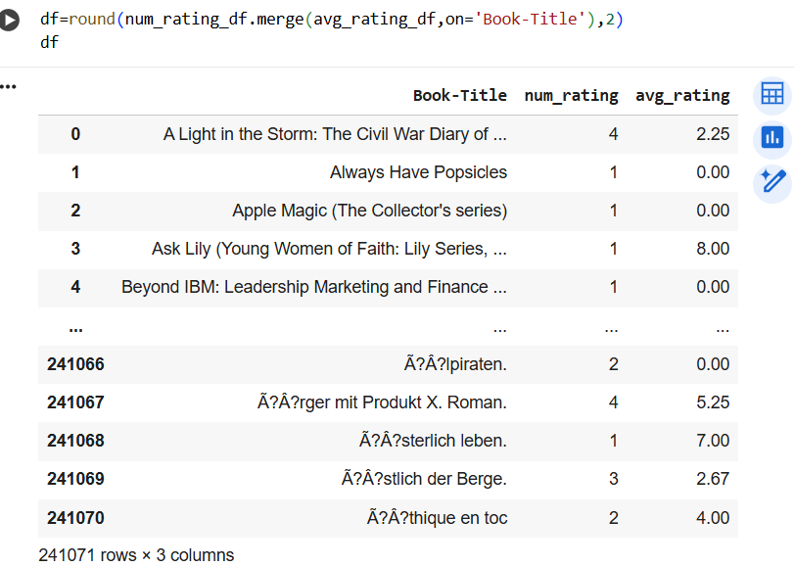
Checking for Null Values
Dropping Columns
Identifying categorical columns & filling with mode
Merging Columns
Using mode imputation ensures that missing entries are replaced with the most common and representative category, helping maintain data consistency.

Slide 6
This operation is a data cleaning step in EDA or preprocessing, specifically targeting missing values in categorical features
It prevents data loss
It avoids introducing unrealistic or rare values.

Slide 7
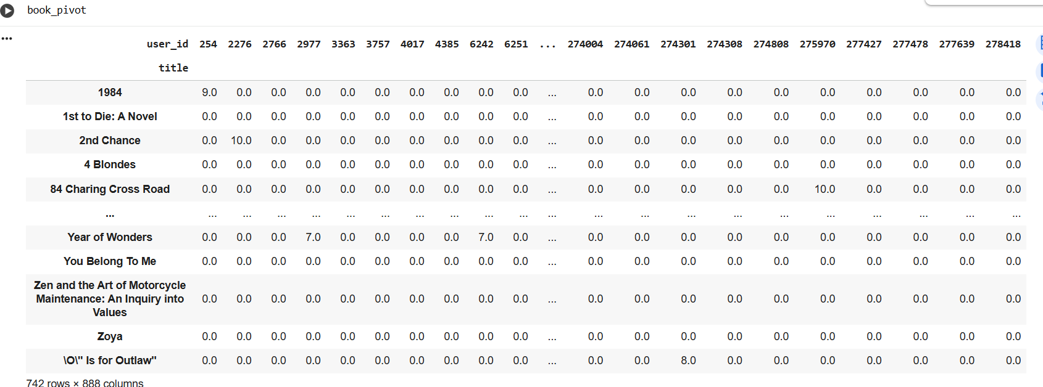
Pivot Table
The pivot table displays books (titles) as rows and user IDs as columns.
Each cell represents the rating a specific user gave to a particular book.
Missing values have been replaced with 0 — to prepare the matrix for similarity computation
This matrix will now act as the input base for generating personalized book recommendations.

Slide 8
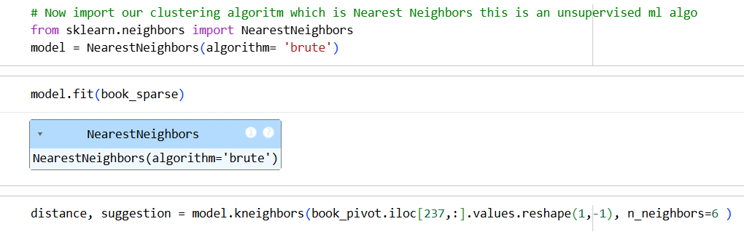
Training the Model
Cosine_similarity() measures how similar two items (books) are, based on their user ratings.
Cosine similarity computes the angle between these vectors
Nearest Neighbors is an unsupervised learning algorithm that groups items (books) based on their similarity.
The model is fitted on the sparse matrix, preparing it to find the closest (most similar) books
Finds 6 nearest neighbors (similar books) to the book at index 237 in the pivot table.

Slide 9

Inferences
Cosine Similarity was calculated to measure how closely books relate based on user rating patterns.
The Nearest Neighbors (unsupervised) algorithm was applied to identify books with the most similar rating vectors.
Both the pivot table and similarity matrix were saved using pickle for faster reuse and model deployment.
The model successfully recommends top-N similar books for any selected title

Slide 10
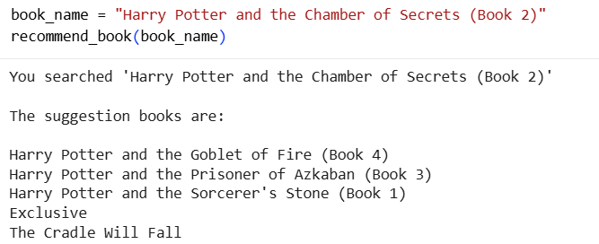
Testing the Model
The recommendation function successfully identifies and suggests books that are most similar to the user’s selected title based on rating patterns.
When user searches for “Harry Potter and the Chamber of Secrets (Book 2)”, the model recommends other closely related titles from the same series
Cosine similarity + nearest neighbor model effectively captures contextual and genre-based similarity between books.
Further tuning — such as improving similarity thresholds or incorporating content-based features (author, genre, summary).

Slide 11
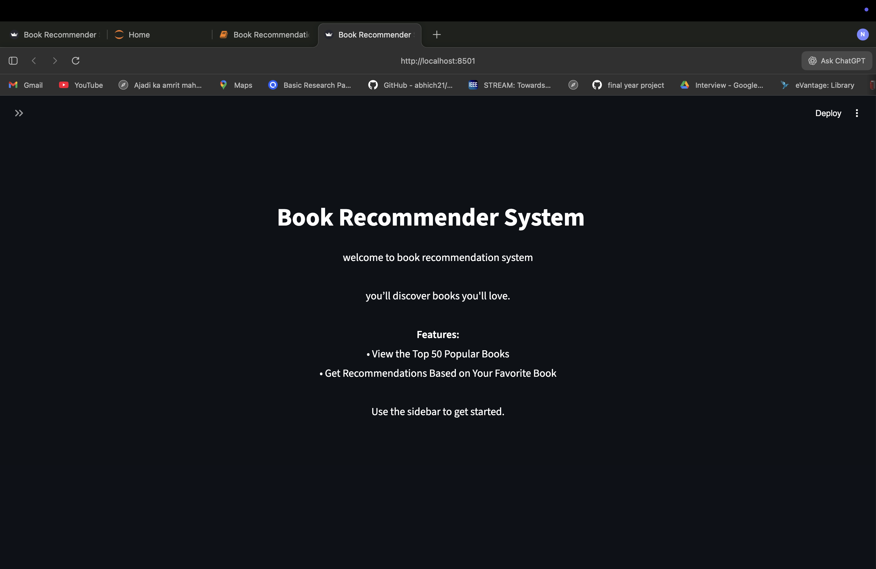
Recommendation System

Slide 12


Slide 13


Slide 14


Slide 15


Slide 16
USER - TO - USER RECOMMENDATION
The model recommends books to a user by identifying other users with similar reading and rating patterns.
The system assumes that users who agreed in the past will have similar preferences in the future
Works well when there is a large number of users with overlapping interests.
Example :
If User A and User B have rated several books similarly, and User B liked “Harry Potter and the Goblet of Fire” (which User A hasn’t read), the system will recommend that book to User A.

Slide 17
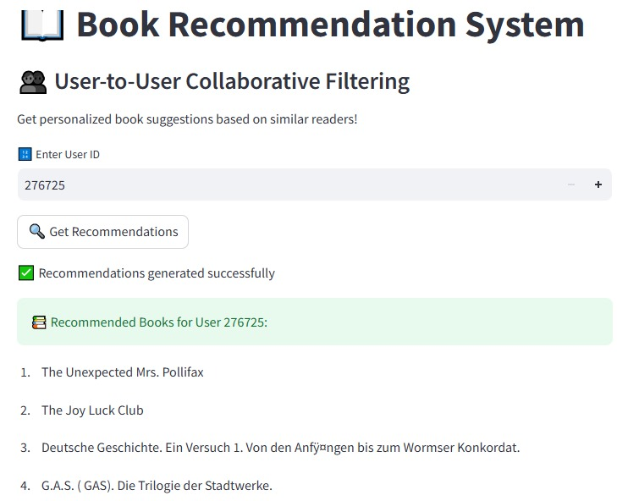

Slide 18
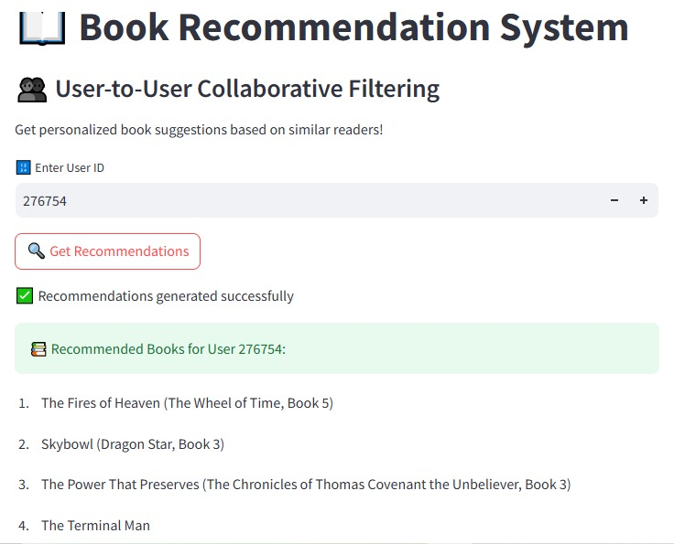

Slide 19

Limitations Encountered
Faced data referencing errors where title and user_id columns were not recognized by the model
The issue occurred due to changes in column names or indexing during data transformation.
Required additional debugging to ensure consistent column mapping across all dataframes.

Slide 20


